Slide 1
Lexical Analysis Chapter -3
CSE375
Dr. Shamim H Ripon
CSE, EWU

Slide 2
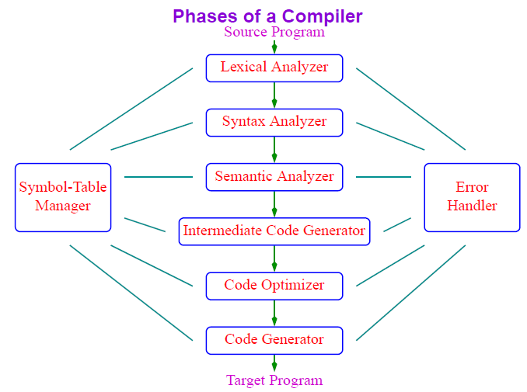

Slide 3
Outline
Role of lexical analyzer
Specification of tokens
Recognition of tokens
Lexical analyzer generator
Finite automata
Design of lexical analyzer generator

Slide 4
Lexical Analyser
First phase of a compiler
Main task
To read the input characters
To produce a sequence of tokens used by the parser for syntax analysis
As an assistant of parser

Slide 5
The role of lexical analyzer
Interaction of lexical analyzer with parser
token
Source
program
Lexical Analyzer
Parser
To semantic
analysis
getNextToken
Symbol
table

Slide 6
The role of the lexical analyzer
Processes in lexical analyzers
Scanning
Pre-processing
Strip out comments and white space
Macro functions
Correlating error messages from compiler with source program
A line number can be associated with an error message
Lexical analysis

Slide 7
The role of the lexical analyzer
Terms of the lexical analyzer
Token
Types of words in source program
Keywords, operators, identifiers, constants, literal strings, punctuation symbols(such as commas, semicolons)
Lexeme
Actual words in source program
Pattern
A rule describing the set of lexemes that can represent a particular token in source program
Relation {<.<=,>,>=,==,<>}

Slide 8
Tokens, Patterns and Lexemes
The words generated by the linear analysis may be of different kinds:
identifier,
keyword (if, while, ...),
punctuation character,
multi-character operator (:=, ->, ...).
Such a kind is called a TOKEN and an element of a kind is called a LEXEME.
A word is recognized to be a lexeme for a certain token by PATTERN MATCHING. For instance letter followed by letters and digits is a pattern that matches a word like x or y with the token id (= identifier).

Slide 9
Token | Lexeme | Pattern
ID | x y n0 | letter followed by letters and digits
NUM | -123 1.456e-5 | any numeric constant
IF | if | if
LPAREN | ( | (
LITERAL | ``Hello'' | any string of characters (except ``) between `` and ``

Slide 10
Attributes for tokens
E = M * C ** 2
<id, pointer to symbol table entry for E>
<assign-op>
<id, pointer to symbol table entry for M>
<mult-op>
<id, pointer to symbol table entry for C>
<exp-op>
<number, integer value 2>

Slide 11
Lexical errors
Some errors are out of power of lexical analyzer to recognize:
fi (a == f(x)) …
However it may be able to recognize errors like:
d = 2r
Such errors are recognized when no pattern for tokens matches a character sequence

Slide 12
Error recovery
Panic mode: successive characters are ignored until we reach to a well formed token
Delete one character from the remaining input
Insert a missing character into the remaining input
Replace a character by another character
Transpose two adjacent characters

Slide 13
Two issues in lexical analysis.
How to specify tokens (patterns)?
How to recognize the tokens giving a token specification (how to implement the nexttoken() routine)?
How to specify tokens:
all the basic elements in a language must be tokens so that they can be recognized.
Token types: constant, identifier, reserved word, operator and misc. symbol.
Tokens are specified by regular expressions.
main() {
int i, j;
for (I=0; I<50; I++) {
printf(“I = %d”, I);
}
}

Slide 14
Specification of tokens
In theory of compilation regular expressions are used to formalize the specification of tokens
Regular expressions are means for specifying regular languages
Example:
Letter_(letter_ | digit)*
Each regular expression is a pattern specifying the form of strings

Slide 15
Specification of Tokens
Regular Expression & Regular language
Regular Expression
A notation that allows us to define a pattern in a high level language.
Regular language
Each regular expression r denotes a language L(r) (the set of sentences relating to the regular expression r)
Notes: Each word in a program can be expressed in a regular expression

Slide 16
Some definitions
alphabet : a finite set of symbols. E.g. {a, b, c}
A string over an alphabet is a finite sequence of symbols drawn from that alphabet (sometimes a string is also called a sentence or a word).
A language is a set of strings over an alphabet.
Operation on languages (a set):
union of L and M, L U M = {s|s is in L or s is in M}
concatenation of L and M
LM = {st | s is in L and t is in M}
Kleene closure of L,
Positive closure of L,
Example:
L={aa, bb, cc}, M = {abc}

Slide 17
Formal definition of Regular expression:f
Given an alphabet ,
(1) is a regular expression that denote { }, the set that contains the empty string.
(2) For each , a is a regular expression denote {a}, the set containing the string a.
(3) r and s are regular expressions denoting the language (set) L(r ) and L(s ). Then
( r ) | ( s ) is a regular expression denoting L( r ) U L( s )
( r ) ( s ) is a regular expression denoting L( r ) L ( s )
( r )* is a regular expression denoting (L ( r )) *
Regular expression is defined together with the language it denotes.

Slide 18
Specification of Tokens
Algebraic laws of regular expressions
1) α|β= β|α
2) α|(β|γ)=(α|β)|γ α(βγ) =(α β)γ
3) α(β|γ )= αβ | αγ (α|β)γ= αγ| βγ
4) εα = αε = α
5)(α*)*=α*
6) α*=α＋|ε α＋ ＝ α α* = α*α
7) (α|β)*= (α* |β *)*= (α* β*)*

Slide 19
Specification of Tokens
Algebraic laws of regular expressions
8) If ε∉L(γ),then
α= β| γ α α= γ* β
α= β| α γ α= β γ*
Notes: We assume that the precedence of * is the highest, the precedence of | is the lowest and they are left associative

Slide 20
Specification of Tokens
Notational Short-hands
a)One or more instances
( r )⁺ digit⁺
b)Zero or one instance
r? is a shorthand for r|ε (E(+|-)?digits)?
c)Character classes
[a-z] denotes a|b|c|…|z
[A-Za-z] [A-Za-z0-9]

Slide 21
Examples:
let
a | b
(a | b) (a | b)
a *
(a | b)*
a | a*b
We assume that ‘*’ has the highest precedence and is left associative. Concatenation has second highest precedence and is left associative and ‘|’ has the lowest precedence and is left associative
(a) | ((b)*(c ) ) = a | b*c

Slide 22
Regular definition.
gives names to regular expressions to construct more complicate regular expressions.
d1 -> r1
d2 ->r2
…
dn ->rn
example:
letter -> A | B | C | … | Z | a | b | …. | z
digit -> 0 | 1 | 2 | 3 | 4 | 5 | 6 | 7 | 8 | 9
identifier -> letter (letter | digit) *
more examples: integer constant, string constants, reserved words, operator, real constant.

Slide 23
Recognition of tokens
Starting point is the language grammar to understand the tokens:
stmt -> if expr then stmt
| if expr then stmt else stmt
| Ɛ
expr -> term relop term
| term
term -> id
| number

Slide 24
Recognition of tokens (cont.)
The next step is to formalize the patterns:
digit -> [0-9]
Digits -> digit+
number -> digit(.digits)? (E[+-]? Digit)?
letter -> [A-Za-z_]
id -> letter (letter|digit)*
If -> if
Then -> then
Else -> else
Relop -> < | > | <= | >= | = | <>
We also need to handle whitespaces:
ws -> (blank | tab | newline)+

Slide 25
Recognition of Tokens
Transition Diagram(Stylized flowchart)
Depict the actions that take place when a lexical analyzer is called by the parser to get the next token
Accepting state
start
>
=
0
6
7
return(relop,GE)
other
Start state
*
8
return(relop,GT)
Notes: Here we use ‘*’ to indicate states on which input retraction must take place

Slide 26
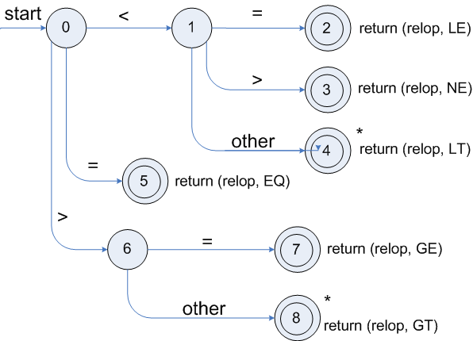
Transition diagrams
Transition diagram for relop

Slide 27
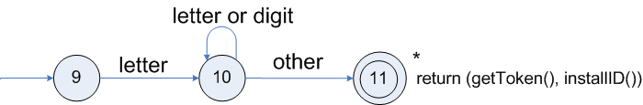
Transition diagrams (cont.)
Transition diagram for reserved words and identifiers

Slide 28
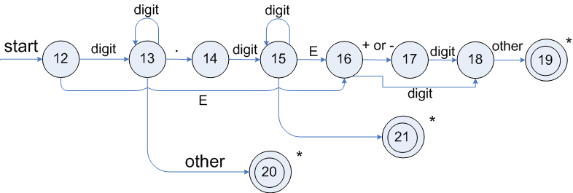
Transition diagrams (cont.)
Transition diagram for unsigned numbers

Slide 29
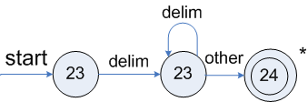
Transition diagrams (cont.)
Transition diagram for whitespace

Slide 30
Finite Automata
Regular expressions = specification
Finite automata = implementation
A finite automaton consists of
An input alphabet Σ
A set of states S
A start state n
A set of accepting states F ⊆ S
A set of transitions state →^{input} state

Slide 31


